Slide 1


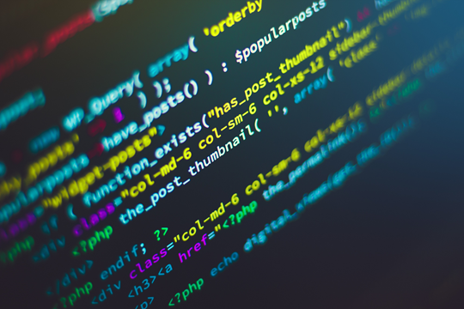

Slide 2


PYTHON
Your first Python Program

Slide 3
PYTHON
Type the following code in any text editor or an IDE and save it as hello_world.py
print("Hello, world!")
Then, run the file. You will get the following output.
Hello, world! Congratulations! You just wrote your first program in Python.

Slide 4
PYTHON Keywords and Identifiers
Keywords are the reserved words in Python.
We cannot use a keyword as a variable name, function name or any other identifier. They are used to define the syntax and structure of the Python language. In Python, keywords are case sensitive.
There are 33 keywords in Python 3.7

Slide 5
PYTHON Keywords and Identifiers
False
Await
Else
Import
Pas
None
Break
Except
In
raise
True
Class
Finally
Is
Return
And
Continue
For
lambda
try
as
Def
From
Nonlocal
While
Assert
Del
global
Not
With
Async
Elif
If
Or
yield

Slide 6
PYTHON Keywords and Identifiers
Python Identifiers
An identifier is a name given to entities like class, functions, variables, etc. It helps to differentiate one entity from another.
Rules for writing identifiers
Identifiers can be a combination of letters in lowercase (a to z) or uppercase (A to Z) or digits (0 to 9) or an underscore _.

Slide 7
PYTHON Keywords and Identifiers
Python Identifiers
Names like myClass, var_1 and print_this_to_screen, all are valid example.
An identifier cannot start with a digit. 1variable is invalid, but variable1 is a valid name.
Keywords cannot be used as identifiers.

Slide 8
PYTHON Keywords and Identifiers
Python Identifiers
Keywords cannot be used as identifiers.
We cannot use special symbols like !, @, #, $, % etc. in our identifier.
An identifier can be of any length.
Python is a case-sensitive language. This means, Variable and variable are not the same.

Slide 9
PYTHON Statement, Indentation and Comments
Instructions that a Python interpreter can execute are called statements. For example, a = 1 is an assignment statement.
Others are ,if statement, for statement, while statement, etc..

Slide 10
PYTHON Statement, Indentation and Comments
Multi-line statement
In Python, the end of a statement is marked by a newline character. But we can make a statement extend over multiple lines with the line continuation character (\). For example:
a = 1 + 2 + 3 + \
4 + 5 + 6 + \
7 + 8 + 9

Slide 11
PYTHON Statement, Indentation and Comments
This is an explicit line continuation. In Python, line continuation is implied inside parentheses ( ), brackets [ ], and braces { }. For instance, we can implement the above multi-line statement as:
a = (1 + 2 + 3 +
4 + 5 + 6 +
7 + 8 + 9)

Slide 12
PYTHON Statement, Indentation and Comments
We can also put multiple statements in a single line using semicolons, as follows:
a = 1; b = 2; c = 3

Slide 13
PYTHON Statement, Indentation and Comments
Python Indentation
Most of the programming languages like C, C++, and Java use braces { } to define a block of code. Python, however, uses indentation.
A code block (body of a function, loop, etc.) starts with indentation and ends with the first unindented line. The amount of indentation is up to you, but it must be consistent throughout that block.
Generally, four whitespaces are used for indentation and are preferred over tabs. Here is an example.

Slide 14
PYTHON Statement, Indentation and Comments
Python Indentation
Generally, four whitespaces are used for indentation and are preferred over tabs. Here is an example.
for i in range(1,11):
print(i)
if i == 5:
break

Slide 15
PYTHON Statement, Indentation and Comments
Python Indentation
The enforcement of indentation in Python makes the code look neat and clean. This results in Python programs that look similar and consistent.

Slide 16
PYTHON Statement, Indentation and Comments
Python Indentation
Indentation can be ignored in line continuation, but it's always a good idea to indent. It makes the code more readable.
both are valid and do the same thing, but the former style is clearer.
For example:
if True:
print('Hello')
a = 5
if True: print('Hello'); a = 5

Slide 17
PYTHON Statement, Indentation and Comments
Python Comments
Comments are very important while writing a program. They describe what is going on inside a program, so that a person looking at the source code does not have a hard time figuring it out.
You might forget the key details of the program you just wrote in a month's time. So taking the time to explain these concepts in the form of comments is always fruitful.In Python, we use the hash (#) symbol to start writing a comment.

Slide 18
PYTHON Statement, Indentation and Comments
Python Comments
#This is a comment
#print out Hello
print('Hello')

Slide 19
PYTHON Statement, Indentation and Comments
Python Comments
Multi-line comments
We can have comments that extend up to multiple lines. One way is to use the hash(#) symbol at the beginning of each line.
#This is a long comment
#and it extends
#to multiple lines

Slide 20
PYTHON Statement, Indentation and Comments
Python Comments
Another way of doing this is to use triple quotes, either ''' or """.
These triple quotes are generally used for multi-line strings. But they can be used as a multi-line comment as well. Unless they are not docstrings, they do not generate any extra code.
"""This is also a perfect example of multi-line comments"""

Slide 21
PYTHON Statement, Indentation and Comments
Python Comments
Another way of doing this is to highlight the entire text and the use ctrl+ /
#This is also a
# perfect example of
#multi-line comments

Slide 22
PYTHON
Docstrings in Python
A docstring is short for documentation string.
Python docstrings (documentation strings) are the string literals that appear right after the definition of a function, method, class, or module.
Triple quotes are used while writing docstrings

Slide 23
PYTHON
For example:
def double(num):
"""Function to double the value"""
return 2*num
Docstrings appear right after the definition of a function, class, or a module. This separates docstrings from multiline comments using triple quotes.
The docstrings are associated with the object as their __doc__ attribute.

Slide 24
PYTHON
For example:
So, we can access the docstrings of the above function with the following lines of code:
def double(num):
"""Function to double the value"""
return 2*num
print(double.__doc__)

Slide 25

PYTHON
Python Variables, Constants and Literals
A variable is a named location used to store data in the memory. It is helpful to think of variables as a container that holds data that can be changed later in the program.In Python, we don't actually assign values to the variables. Instead, Python gives the reference of the object(value) to the variable.
number = 10
Here, we have created a variable named number. We have assigned the value 10 to the variable.
You can think of variables as a bag to store books in it and that book can be replaced at any time.
number = 10
number = 1.1
Initially, the value of number was 10. Later, it was changed to 1.1

Slide 26
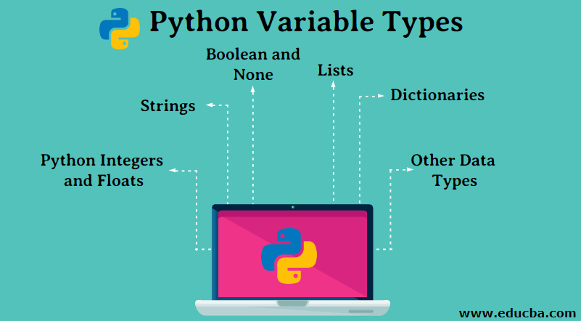
PYTHON

Slide 27
PYTHON
Variables in Python
A variable in python is a memory location associated with some name in order to store some form of data and retrieve it when required.
We can store different types of data in the variable and reuse the same variable for storing some other data any number of times.
For using a variable in python , we have to first define it to tell the compiler about its existence so that compiler can allocate the required memory to it.

Slide 28
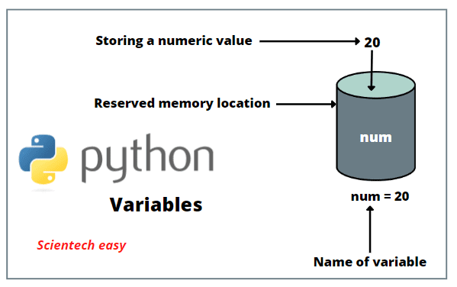
PYTHON

Slide 29
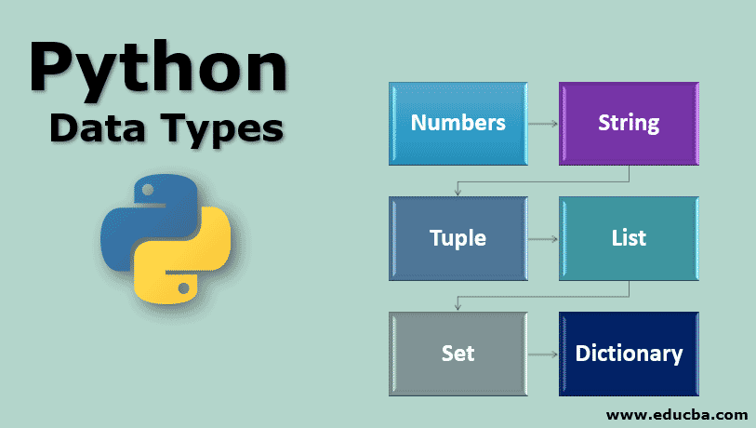
PYTHON

Slide 30
PYTHON
Variables in Python
Variables are containers for storing data values. A Variable van be describrd as a name given to a memory location. It is the basic unit of storage in a program.
The value stored in a variable can be changed during program execution.
A variable is only a name given to a memory location, all the operations done on the variable effects that memory location.
In Python , variables kneed to be defined , but do not kneed declared before use.

Slide 31
PYTHON
Variables and data types in Python
The value stored in a variable can be changed during program execution.there are different types of variables (defined with different keywords)
All variables use data type during declaration to restrict the type of data to be stored.
Therefore, we can say that data types are used to tell the variables the type of data they can store.

Slide 32
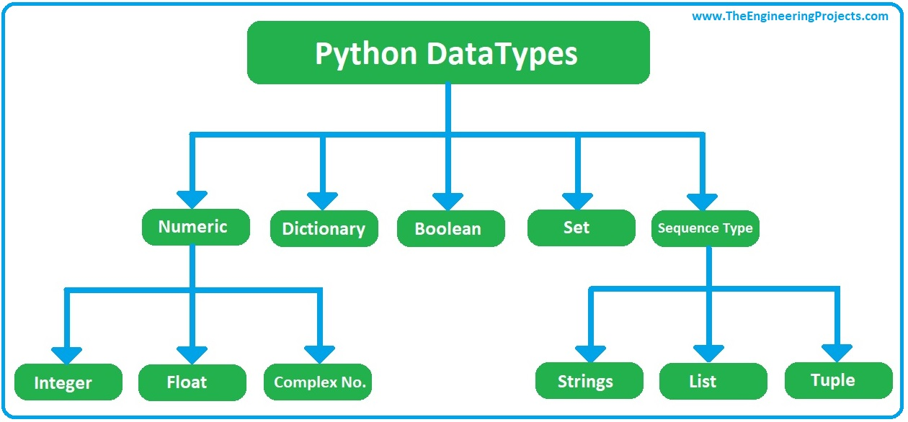
PYTHON

Slide 33
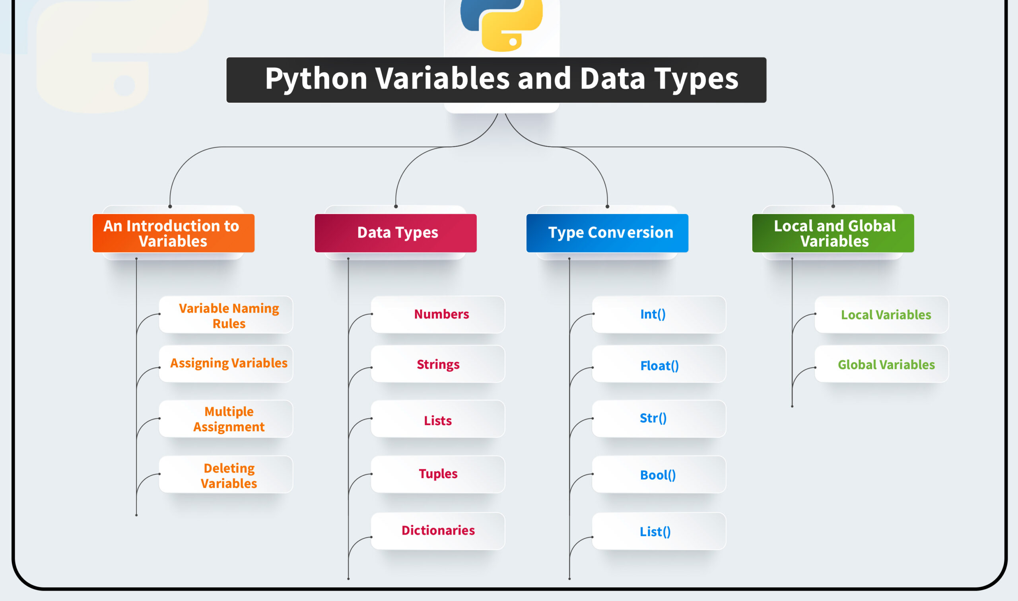
PYTHON

Slide 34
PYTHON
Assigning values to Variables in Python
Whenever a variable is defined in python, the compiler allocates some memory for that variable based on the data type with which it is declared.
Every data type requires a different amount of memory.
Supports a wide variety of data types and the programmer can select the data type appropriate to the needs of the application. Data types specify the size and types of values to be stored.

Slide 35
PYTHON
Assigning values to Variables in Python
Declaring and assigning value to a variable
website = “hiitplc.com"
print(website)
Python is a type-inferred language, so you don't have to explicitly define the variable type. It automatically knows that hiitplc.com is a string and declares the website variable as a string.

Slide 36
PYTHON
Changing the value of a variable
Declaring and assigning value to a variable
website = “hiitplc.com"
print(website)
# assigning a new value to website
website = “google.com“
print(website)
Python is a type-inferred language, so you don't have to explicitly define the variable type. It automatically knows that apple.com is a string and declares the website variable as a string.

Slide 37
PYTHON
Assigning multiple values to multiple variables
a, b, c = 5, 3.2, "Hello"
print (a)
print (b)
print (c)
Python is a type-inferred language, so you don't have to explicitly define the variable type. It automatically knows that apple.com is a string and declares the website variable as a string.

Slide 38
PYTHON
Assigning single value to multiple variables
x = y = z = "same"
print (x)
print (y)
print (z)
Python is a type-inferred language, so you don't have to explicitly define the variable type. It automatically knows that apple.com is a string and declares the website variable as a string.

Slide 39
PYTHON
Constants
A constant is a type of variable whose value cannot be changed. It is helpful to think of constants as containers that hold information which cannot be changed later.
You can think of constants as a bag to store some books which cannot be replaced once placed inside the bag.
……
……

Slide 40
PYTHON
Assigning value to constant in Python
In Python, constants are usually declared and assigned in a module.
Here, the module is a new file containing variables, functions, etc which is imported to the main file. Inside the module, constants are written in all capital letters and underscores separating the words.
Example Declaring and assigning value to a constant
Create a myconstant.py:
PI = 3.14
GRAVITY = 9.8

Slide 41
PYTHON
Assigning value to constant in Python
Create a mains.py:
import myconstants
print(myconstants.PI)
print(myconstants.GRAVITY)
Create a mains.py In the above program, we create a myconstants.py module file. Then, we assign the constant value to PI and GRAVITY. After that, we create a mains.py file and import the constant module. Finally, we print the constant value.
Note: In reality, we don't use constants in Python. Naming them in all capital letters is a convention to separate them from variables, however, it does not actually prevent reassignment.

Slide 42
PYTHON
Rules and Naming Convention for Variables and constants
Constant and variable names can have a combination of letters in lowercase (a to z) or uppercase (A to Z) or digits (0 to 9) or an underscore (_). For example:
snake_case
MACRO_CASE
camelCase
CapWords
…….
………

Slide 43
PYTHON
Rules and Naming Convention for Variables and constants
If you want to create a variable name having two words, use underscore to separate them.
For example:
Value_one
Value_two
ValueOne
ValueTwo
Value1
Value_1
Use capital letters possible to declare a constant.
…….
………

Slide 44


